Slide 1


Case Study on Zomato Ltd.
Using
MySQL Database

Slide 2
Case study on ZomAto.Ltd
Brief Overview of the Company
Zomato Ltd. is a leading online food delivery and restaurant discovery platform that connects customers with various restaurants and food outlets across multiple cities. Founded in 2008, Zomato has grown into a global brand that offers services such as food ordering, restaurant reviews, ratings, table reservations, and subscription-based loyalty programs.
Data Needs to Be Stored
To effectively manage the operations of Zomato Ltd., the database must store structured information about all entities involved in the food delivery ecosystem. These entities include customers, restaurants, menu items, orders, payments, deliveries, and reviews. Properly organizing and storing this data enables seamless food ordering, tracking, customer service, and business analytics.

Slide 3
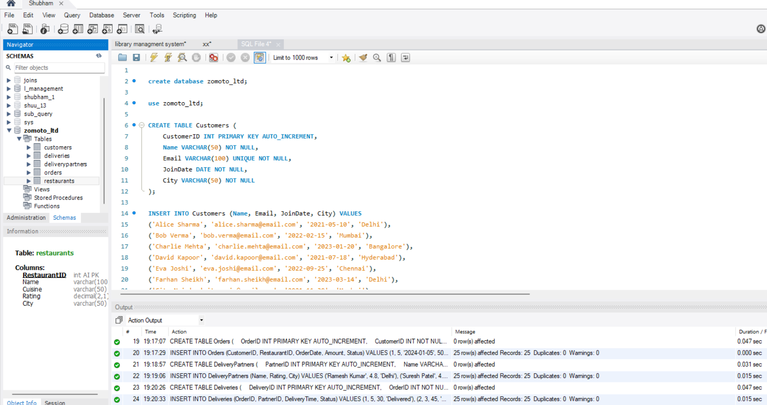
Case study on ZomAto.Ltd
Created All The Tables With Primary Keys

Slide 4
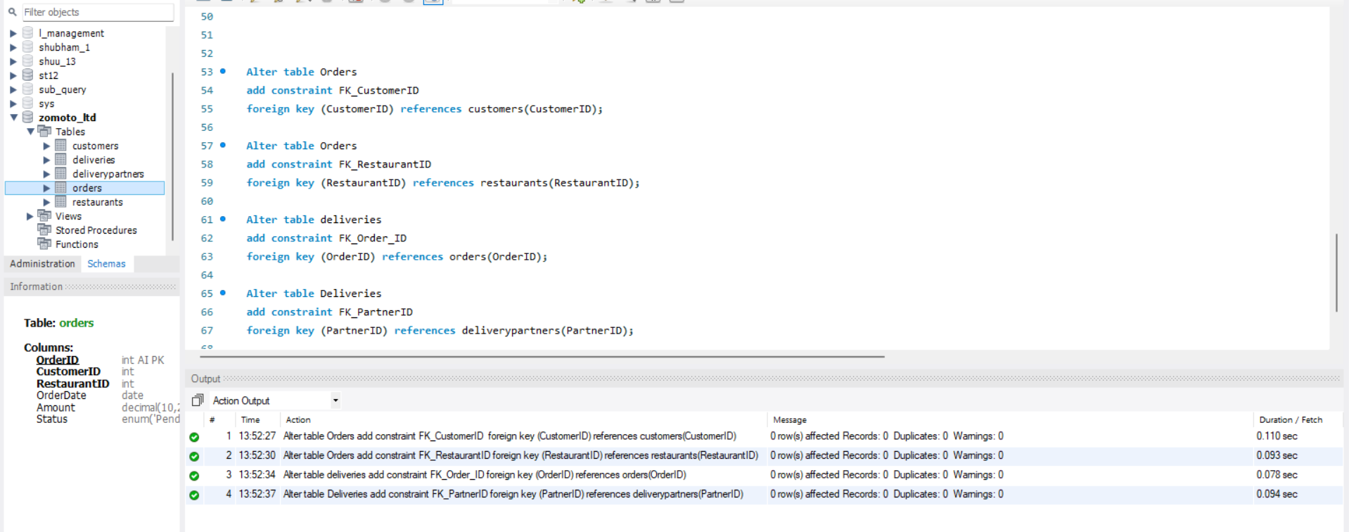
Added Foreign Key

Slide 5
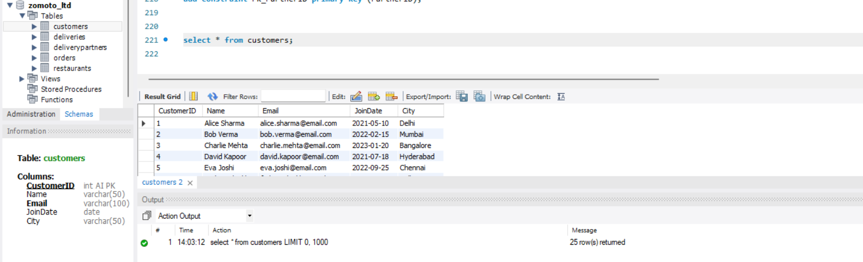
Basic Select Statement to See a Table

Slide 6
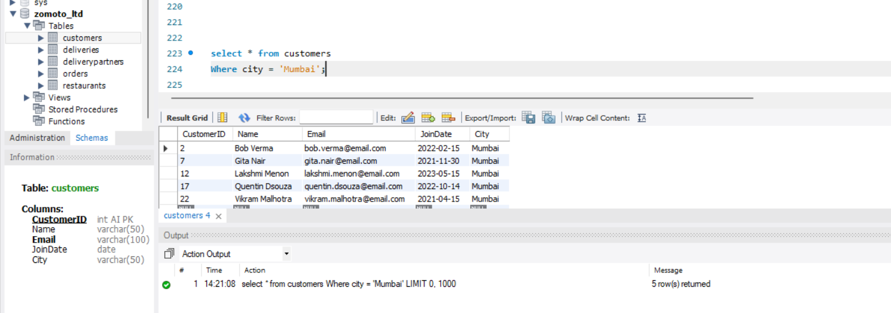
Show all customer details who are from Mumbai.

Slide 7
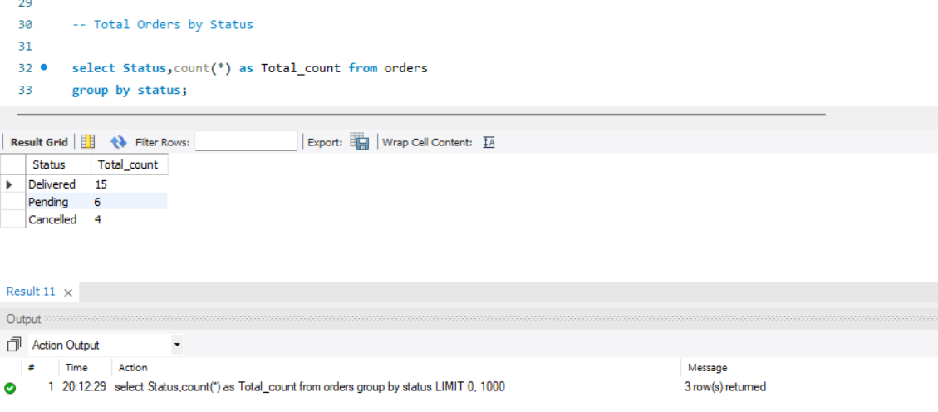
Total Orders by Status

Slide 8
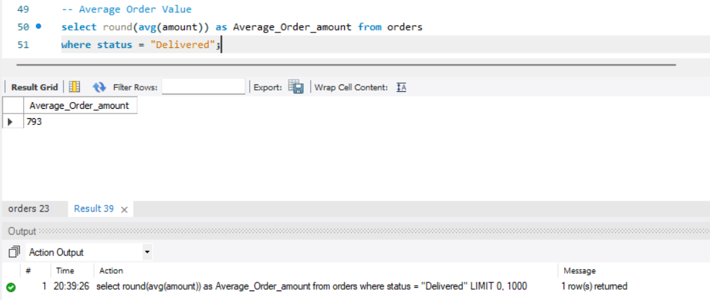
Average Order Value (AOV)

Slide 9
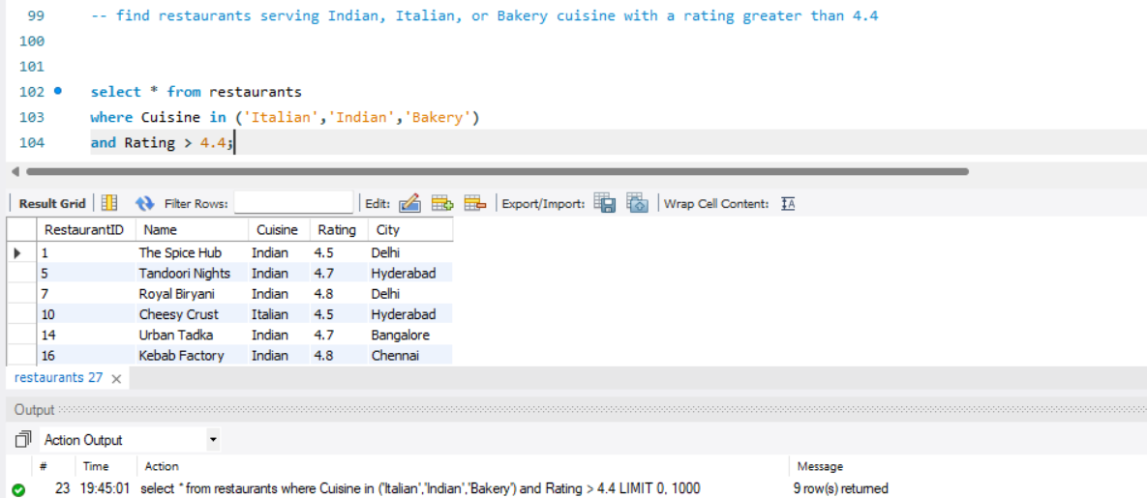
Find restaurants serving Indian, Italian, or Bakery cuisine with a rating greater than 4.4

Slide 10
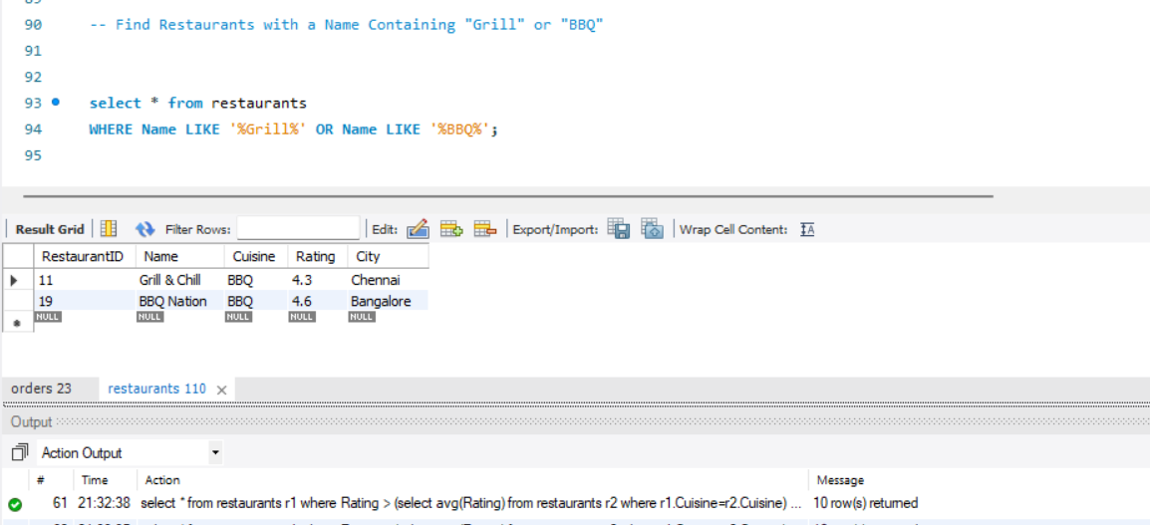
Find Restaurants with a Name Containing Grill or BBQ

Slide 11
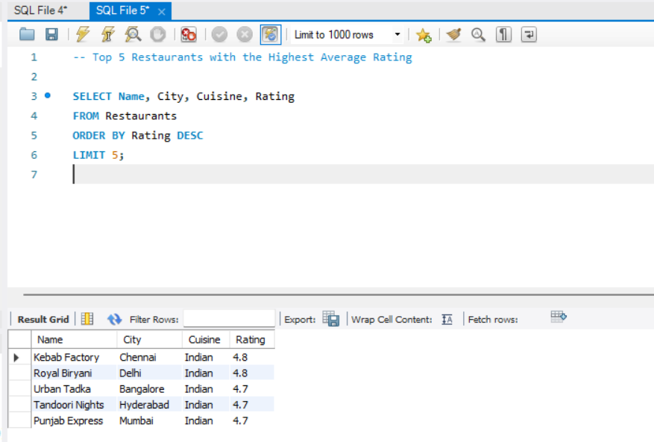
Top 5 Restaurants with the Highest Average Rating

Slide 12
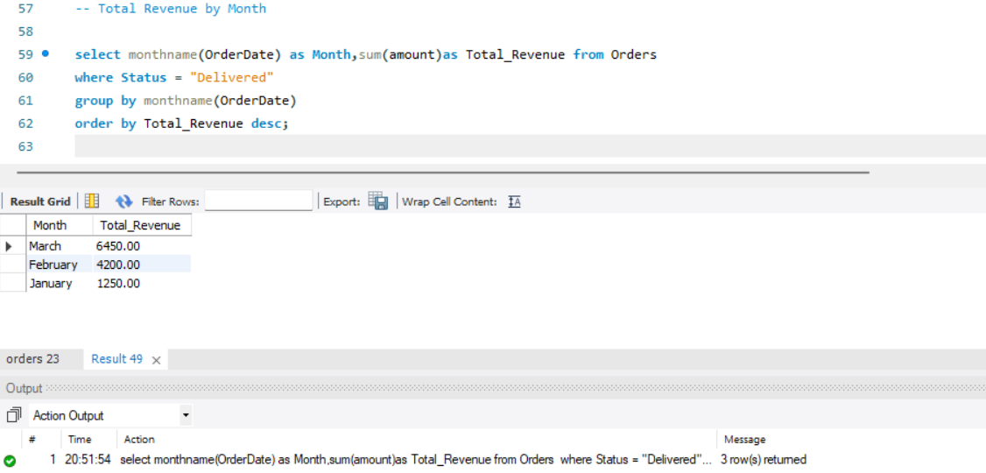
Total Revenue by Month

Slide 13
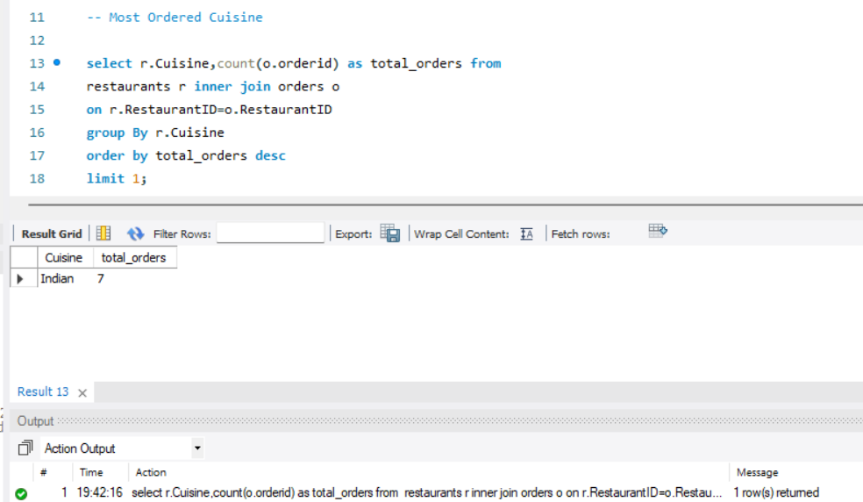
Most Ordered Cuisine

Slide 14
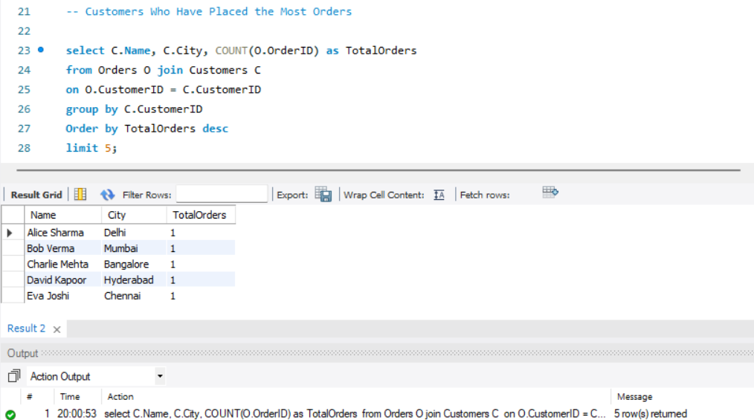
Customers Who Have Placed the Most Orders

Slide 15
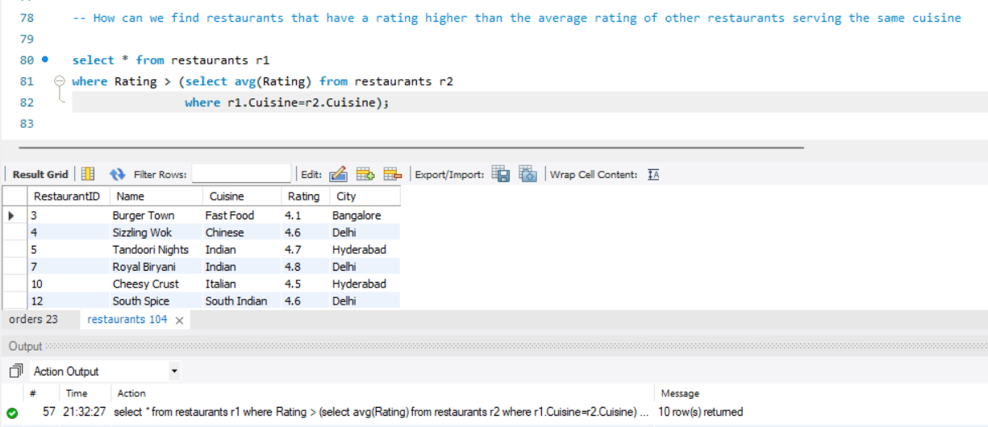
How can we find restaurants that have a rating higher than the average rating of other restaurants serving the same cuisine

Slide 16
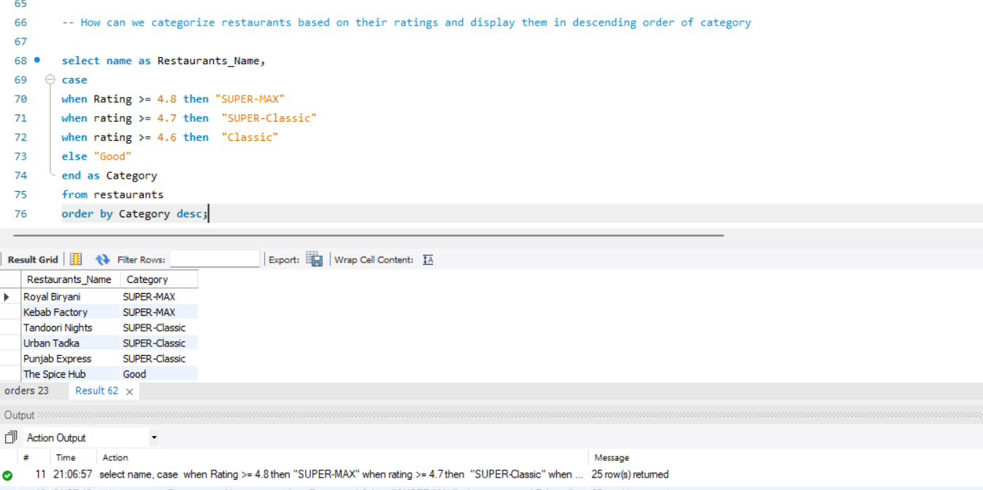
How can we categorize restaurants based on their ratings and display them in descending order of category

Slide 17
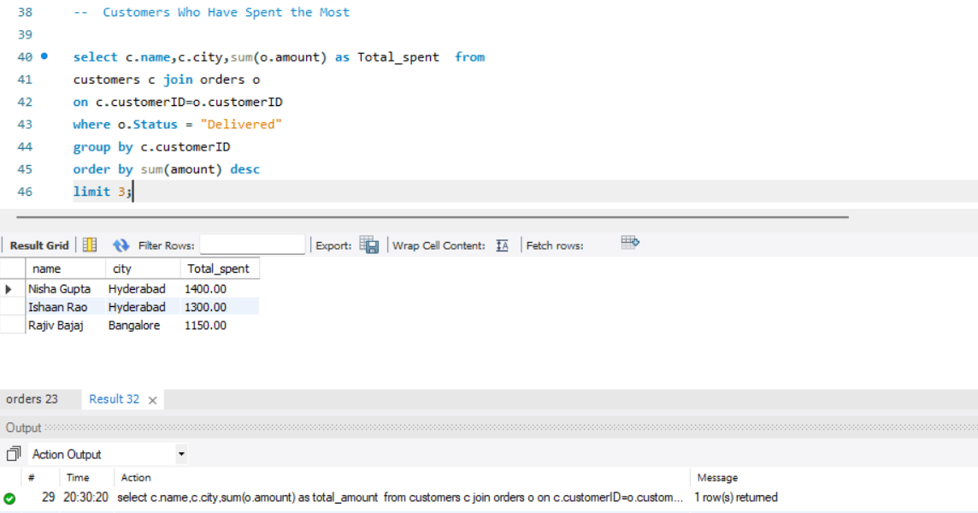
Customers Who Have Spent the Most

Slide 18
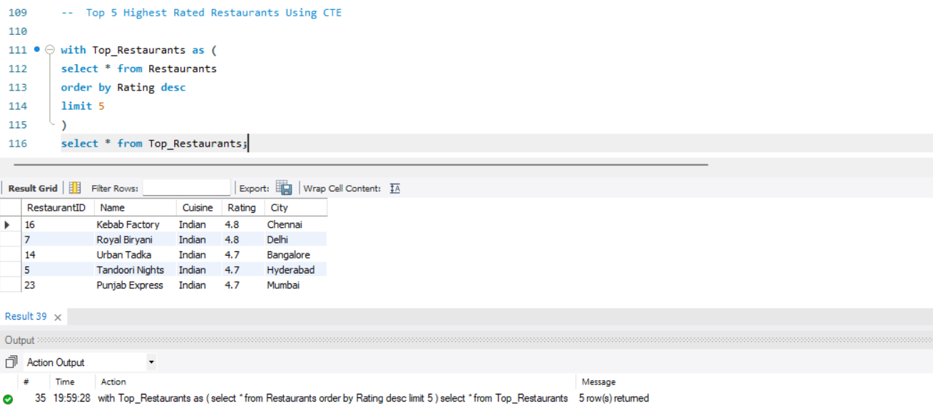
Top 5 Highest Rated Restaurants Using CTE

Slide 19
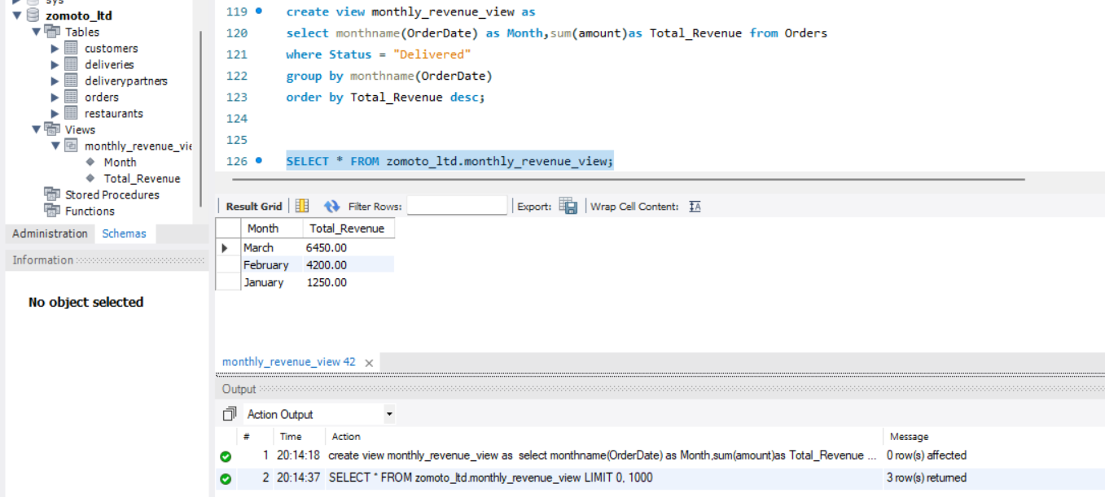
Create View: Monthly Revenue from Delivered Orders

Slide 20
Thank You

